Slide 1
Network Programming
Ung Văn Giàu
Email: giau.ung@eiu.edu.vn

Slide 2
AWK Utility
One of the most prominent text-processing utility on GNU/Linux
Notes:
It is very powerful and uses simple programming language.
It can solve complex text processing tasks with a few lines of code.

Slide 3
1. Overview
AWK is an interpreted programming language
It is very powerful and specially designed for text processing
It is often referred to as GNU AWK
  The version of AWK that GNU/Linux distributes is written and maintained by the Free Software Foundation (FSF)
Notes:
Its name is derived from the family names of its authors − Alfred Aho, Peter Weinberger, and Brian Kernighan.

Slide 4
1. Overview
Types of AWK:
  AWK
    Original AWK from AT & T Laboratory
  NAWK
    Newer and improved version of AWK from AT & T Laboratory
  GAWK
    It is GNU AWK
    All GNU/Linux distributions ship GAWK
    It is fully compatible with AWK and NAWK

Slide 5
1. Overview
Typical Uses of AWK:
Myriad of tasks can be done with AWK:
Text processing
Define variables to store data
Use structured programming concepts to add logic to data processing
if-then statements and loops
Producing formatted text reports
Generate formatted reports by extracting data elements within the data file and repositioning them in another order or format
Performing arithmetic operations
Performing string operations, and many more
Notes:
Myriad: vô số
The gawk program’s report-generating capabilities are often used for extracting data elements from large bulky text files and formatting them into a readable report.
The perfect example of this is formatting log files.
Trying to pore through lines of errors in a log file can be difficult.
The gawk program allows you to filter just the data elements you want to view from the log file, and then you can format them in a manner that makes reading the important data easier.

Slide 6
2. Environment
AWK is available by default on most GNU/Linux distributions
Can use which command to check whether it is present on your system or not
Installation Using Package Manager
  Ubuntu: Advance Package Tool (APT) package manager
  sudo apt-get update
  sudo apt-get install gawk
After installation, ensure that AWK is accessible via command line
  which awk
Notes:
In case you don’t have AWK, then install it on Debian based GNU/Linux using Advance Package Tool (APT) package manager as follows.
/usr/bin/awk

Slide 7
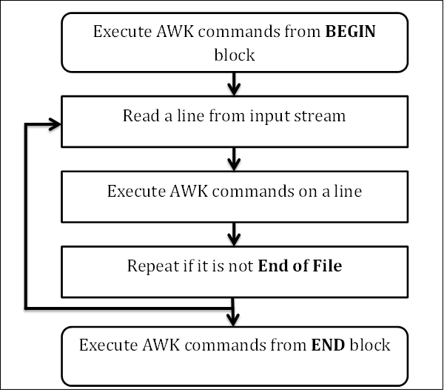
3. Workflow
AWK follows a simple workflow − Read, Execute, and Repeat
Notes:
To become an expert AWK programmer, you need to know its internals (nội hàm).

Slide 8
3. Workflow
Read
  AWK reads a line from the input stream (file, pipe, or stdin) and stores it in memory
Execute
  All AWK commands are applied sequentially on the input
  By default AWK execute commands on every line
  We can restrict this by providing patterns
Repeat
  This process repeats until the file reaches its end

Slide 9
4. Program Structure
BEGIN block
  Syntax: BEGIN {awk-commands}
  The BEGIN block gets executed at program start-up
  It executes only once
  This is good place to initialize variables
  BEGIN is an AWK keyword and hence it must be in upper-case
  Note: This block is optional

Slide 10
4. Program Structure
Body Block
  Syntax: /pattern/ {awk-commands}
  The body block applies AWK commands on every input line
  By default, AWK executes commands on every line. We can restrict this by providing patterns
  There are no keywords for the Body block

Slide 11
4. Program Structure
END Block
  Syntax: END {awk-commands}
  The END block executes at the end of the program.
  END is an AWK keyword and hence it must be in upper-case
  Note: this block is optional

Slide 12
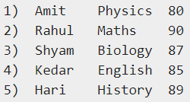
4. Program Structure
Example
Create a data file (marks.txt)
Write AWK code:
awk 'BEGIN { printf "Sr No\tName\tSub\tMarks\n“ }
{ print }' marks.txt
Notes:
At the start, AWK prints the header from the BEGIN block.
Then in the body block, it reads a line from a file and executes AWK's print command which just prints the contents on the standard output stream.
This process repeats until file reaches the end.

Slide 13
5. Basic Syntax
AWK is simple to use
We can provide AWK commands:
either directly from the command line
or in the form of a text file containing AWK commands
AWK Command Line
Specify an AWK command within single quotes
awk [options] ‘awk commands’ [dataFile]
Example: awk '{print}' marks.txt

Slide 14
5. Basic Syntax
AWK Program File
Provide AWK commands in a script file
awk [options] -f awkCommandFile [dataFile]
Example: awk -f command.awk marks.txt
Notes:
AWK Program File
First, create a text file command.awk containing the AWK command: {print}
Now we can instruct the AWK to read commands from the text file and perform the action.

Slide 15
5. Basic Syntax
AWK Standard Options
  The -v option
    assigns a value to a variable
    allows assignment before the program execution
    Example: awk -v name=Jerry 'BEGIN{printf "Name = %s\n", name}'
  The --dump-variables[=file] option
    prints a sorted list of global variables and their final values to file
    The default file is awkvars.out
    Example:
      awk --dump-variables ‘’
      cat awkvars.out
Notes:
AWK supports the following standard options which can be provided from the command line.

Slide 16
5. Basic Syntax
AWK Standard Options
The --help option
prints the help message on standard output
Example: awk --help

Slide 17
6. Basic Examples
Use the data file marks.txt
Printing Column or Field
  instruct AWK to print only certain columns from the input field
  Example: awk '{print $3 "\t" $4}' marks.txt
    $3 and $4 represent the third and the fourth fields respectively from the input record
Printing All Lines
  By default, AWK prints all the lines that match pattern
  Example:
    awk '/a/ {print $0}' marks.txt
    awk '/a/' marks.txt
Notes:
This section describes several useful AWK commands and their appropriate examples.

Slide 18
6. Basic Examples
Printing Columns by Pattern
  instruct AWK to print only certain fields
  Example: awk '/a/ {print $3 "\t" $4}' marks.txt
Printing Column in Any Order
  Example: awk '/a/ {print $4 "\t" $3}' marks.txt
Notes:
Printing Columns by Pattern
When a pattern match succeeds, AWK prints the entire record by default. But you can instruct AWK to print only certain fields. For instance, the following example prints the third and fourth field when a pattern match succeeds.

Slide 19
6. Basic Examples
Counting and Printing Matched Pattern
  count and print the number of lines for which a pattern match succeeded
  Example: awk '/a/{++cnt} END {print "Count = ", cnt}' marks.txt
Printing Lines with More than 18 Characters
  print only those lines that contain more than 18 characters
  Example: awk 'length($0) > 18' marks.txt
    AWK provides a built-in length function that returns the length of the string
    $0 variable stores the entire line
Notes:
Counting and Printing Matched Pattern
In this example, we increment the value of counter when a pattern match succeeds and we print this value in the END block.
Note that unlike other programming languages, there is no need to declare a variable before using it.
Printing Lines with More than 18 Characters
awk 'length($2) >= 5' marks.txt
awk 'length($2) >= 5 {printf $3"\t"$4"\n"}' marks.txt

Slide 20
7. Built-in Variables
Standard AWK variables
  ARGC
    the number of arguments provided at the command line
    Example: awk 'BEGIN {print "Arguments =", ARGC}' One Two Three Four
  ARGV
    an array that stores the command-line arguments
    Example:
      awk 'BEGIN {
      for (i = 0; i < ARGC; ++i) {
      printf "ARGV[%d] = %s\n", i, ARGV[i]
      }
      }' one two three four
Notes:
ARGC
But why AWK shows 5 when you passed only 4 arguments? Just check the following example to clear your doubt.

Slide 21
7. Built-in Variables
Standard AWK variables
  FILENAME
    represents the current file name
    Note: FILENAME is undefined in the BEGIN block
    Example: awk 'END {print FILENAME}' marks.txt
  NF
    represents the number of fields in the current record
    Example: echo -e "One Two\nOne Two Three\nOne Two Three Four" | awk 'NF > 2’
  NR
    represents the number of the current record
    Example: echo -e "One Two\nOne Two Three\nOne Two Three Four" | awk 'NR < 3'
Notes:
NF:
The example prints only those lines that contain more than two fields.
NR:
The example prints the record if the current record number is less than three.
echo -e "One Two\nOne Two Three\nOne Two Three Four" | awk 'NR > 1 && NR < 3’
RSTART
It represents the first position in the string matched by match function.
Example
awk 'BEGIN { if (match("One Two Three", "Thre")) { print RSTART } }'

Slide 22
7. Built-in Variables
Standard AWK variables
  $0
    represents the entire input record
    Example: awk '{print $0}' marks.txt
  $n
    represents the nth field in the current record
    Example: awk '{print $3 "\t" $4}' marks.txt

Slide 23
8. Operators
Arithmetic Operators
  Addition
    awk 'BEGIN { a = 50; b = 20; print "(a + b) = ", (a + b) }’
  Subtraction
    awk 'BEGIN { a = 50; b = 20; print "(a - b) = ", (a - b) }’
  Multiplication
    awk 'BEGIN { a = 50; b = 20; print "(a * b) = ", (a * b) }’
  Division
    awk 'BEGIN { a = 50; b = 20; print "(a / b) = ", (a / b) }’
  Modulus
    awk 'BEGIN { a = 50; b = 20; print "(a % b) = ", (a % b) }'
Notes:
Pat 100 97 58
Sandy 84 72 93
Chris 72 92 89
awk '{ sum = $2 + $3 + $4 ; avg = sum / 3; print $1, avg }' grades

Slide 24
8. Operators
Increment and Decrement Operators
  Pre-Increment/Decrement
    awk 'BEGIN { a = 10; b = ++a; printf "a = %d, b = %d\n", a, b }’
    awk 'BEGIN { a = 10; b = --a; printf "a = %d, b = %d\n", a, b }’
  Post-Increment/Decrement
    awk 'BEGIN { a = 10; b = a++; printf "a = %d, b = %d\n", a, b }’
    awk 'BEGIN { a = 10; b = a--; printf "a = %d, b = %d\n", a, b }'

Slide 25
8. Operators
Assignment Operators
  Simple Assignment (=)
    awk 'BEGIN { name = "Jerry"; print "My name is", name }’
  Shorthand
    awk 'BEGIN { cnt = 10; cnt += 10; print "Counter =", cnt }’
    awk 'BEGIN { cnt = 100; cnt -= 10; print "Counter =", cnt }’
    awk 'BEGIN { cnt = 10; cnt *= 10; print "Counter =", cnt }’
    awk 'BEGIN { cnt = 100; cnt /= 5; print "Counter =", cnt }’
    awk 'BEGIN { cnt = 100; cnt %= 8; print "Counter =", cnt }'

Slide 26
8. Operators
Relational Operators
  Equal to
    awk 'BEGIN { a = 10; b = 10; if (a == b) print "a == b" }’
  Not Equal to
    awk 'BEGIN { a = 10; b = 20; if (a != b) print "a != b" }’
  Less Than
    awk 'BEGIN { a = 10; b = 20; if (a < b) print "a < b" }’

Slide 27
8. Operators
Relational Operators
  Less Than or Equal to
    awk 'BEGIN { a = 10; b = 10; if (a <= b) print "a <= b" }’
  Greater Than
    awk 'BEGIN { a = 10; b = 20; if (b > a ) print "b > a" }’
  Greater Than or Equal to
    awk 'BEGIN { a = 10; b = 20; if (b >= a ) print "b > a" }’

Slide 28
8. Operators
Logical Operators
  Logical AND (&&)
    expr1 && expr2
    awk 'BEGIN {num = 5; if (num >= 0 && num <= 7) printf "%d is in octal format\n", num }’
  Logical OR (||)
    expr1 || expr2
    awk 'BEGIN {ch = "\n"; if (ch == " " || ch == "\t" || ch == "\n") print "Current character is whitespace." }’
  Logical NOT (!)
    ! expr1
    awk 'BEGIN { name = ""; if (! length(name)) print "name is empty string." }'

Slide 29
8. Operators
String Concatenation Operator
  Space is a string concatenation operator that merges two strings
  Example: awk 'BEGIN { str1 = "Hello, "; str2 = "World"; str3 = str1 str2; print str3 }’
Array Membership Operator
  It is represented by in
  Example: awk 'BEGIN {arr[0] = 1; arr[1] = 2; arr[2] = 3; for (i in arr) printf "arr[%d] = %d\n", i, arr[i]}'

Slide 30
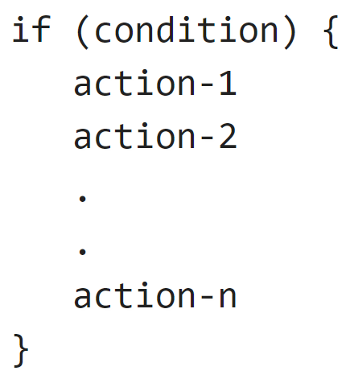
9. Control Flow
If statement
  Syntax:
  Example: awk 'BEGIN {num = 10; if (num % 2 == 0) printf "%d is even number.\n", num }'

Slide 31
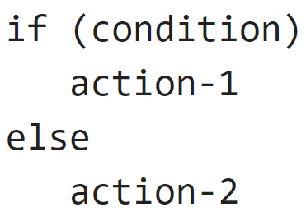
9. Control Flow
If Else Statement
  Syntax:
  Example: awk 'BEGIN {num = 11; if (num % 2 == 0) printf "%d is even number.\n", num; else printf "%d is odd number.\n", num}'

Slide 32
9. Control Flow
If-Else-If Ladder
  Can easily create an if-else-if ladder by using multiple if-else statements
  Example:
    awk 'BEGIN {
    a = 30;
    if (a==10)
    print "a = 10";
    else if (a == 20)
    print "a = 20";
    else if (a == 30)
    print "a = 30";
    }'

Slide 33
10. Loops
Loops are used to execute a set of actions in a repeated manner
The loop execution continues as long as the loop condition is true
For Loop
  Syntax:
    for (initialization; condition; increment/decrement)
    action
  Example:
    awk 'BEGIN { for (i = 1; i <= 5; ++i) print i }'

Slide 34
10. Loops
While Loop
  Syntax:
  while (condition)
  action
  Example:
    awk 'BEGIN {i = 1; while (i < 6) { print i; ++i } }'

Slide 35
11. Pretty Printing
printf function
  Syntax: printf fmt, expr-list
  fmt is a string of format specifications and constants
  expr-list is a list of arguments corresponding to format specifiers
Escape Sequences
  New Line
    awk 'BEGIN { printf "Hello\nWorld\n" }’
  Horizontal Tab
    awk 'BEGIN { printf "Sr No\tName\tSub\tMarks\n" }'
Notes:
So far we have used AWK's print and printf functions to display data on standard output. But printf is much more powerful than what we have seen before. This function is borrowed from the C language and is very helpful while producing formatted output.

Slide 36
11. Pretty Printing
Escape Sequences
  Format Specifier
    %c: prints a single character
    %d and %i: prints only the integer part of a decimal number
    %f: prints a floating point number of the form [-]ddd.dddddd
    %g and %G: uses %e or %f conversion, whichever is shorter, with non-significant zeros suppressed
    %s: prints a character string
      awk 'BEGIN { printf "Name = %s\n", "Sherlock Holmes" }'

Slide 37
Exercise
Notes:
Xem số nhập vào là chẵn hay lẻ
Viết hàm tính số nguyên tố
Xem thử IP đó xuất hiện bao nhiêu lần từ file log
awk '{print $1}' "new-access -2.log" | uniq -c | awk '{print $2": " $1}' > results.txt
awk '{print $1}' "new-access -2.log" | uniq -c | awk '{print $2": " $1}’ | sort -nr -k2
awk '{ip[$1]++} END{for(i in ip) printf "%s %d\n", i, ip[i];}' "new-access -2.log" | awk '{print $2": " $1}' | sort -nr -k1

Slide 38
Q&A

Slide 39
Contents
01
Class Policy
02
Course Evaluation
03
Course Introduction
04
Course Objective
05
Reference

